Slide 1
Energy Efficient Smart Building:- LSTM Neural Networks For Time Series Prediction
Shrinivas Gollalappa Kadaganchi
ID:-700750193
sxk01930@ucmo.edu
Video Link:- https://drive.google.com/file/d/1R11df7adrl8rQxSqDYgQ01m9R0rNuun-/view?usp=drive_link

Slide 2
Motivation
The motivation behind this research stems from the pressing need for efficient resource utilization in the modern technological era. As human resources, time, and energy expenditures continue to increase, there is a growing emphasis on optimizing these resources to meet the demands of a rapidly expanding population and urbanization. In this context, the role of intelligent building systems in campuses and cities becomes crucial, as they can significantly impact resource efficiency and improve the quality of life for residents.
Energy consumption in buildings accounts for a substantial portion of overall energy usage, making it a key area for improvement. By enhancing the energy efficiency of buildings, we can reduce energy waste, minimize operational costs, and contribute to environmental sustainability goals. Smart buildings equipped with advanced technologies can play a transformative role in achieving these objectives.
The City University of New York (CUNY) campuses serve as an ideal setting for this research due to their diverse building structures, energy usage patterns, and potential for implementing smart building solutions. Overall, the motivation for this research lies in the urgency to address resource challenges, promote sustainable practices, and foster advancements in intelligent building systems to create a more energy-efficient and environmentally responsible future.

Slide 3
Problem Statement
The increasing human resources, time, and energy expenditures in modern technology necessitate efficient resource utilization to meet the growing demands of urban environments and improve overall sustainability. In this context, the role of intelligent building systems in campuses and cities becomes crucial, as they have the potential to optimize resource usage and provide comfortable living conditions for residents.
The City University of New York (CUNY) campuses, with their diverse building structures and energy consumption patterns, present an opportunity to address the challenge of improving energy efficiency. The problem at hand is to enhance the energy efficiency of buildings within CUNY campuses through accurate energy consumption prediction. This will enable the development of energy-efficient smart buildings, leading to reduced energy waste, cost savings, and environmental benefits.

Slide 4
Objectives
Investigate and analyze the energy expenditures of buildings within CUNY campuses to identify patterns and trends in energy consumption data.
Develop a Long Short-Term Memory (LSTM) neural network model to accurately predict the energy consumption values of these buildings based on historical time series data.
Assess the effectiveness of the LSTM model in forecasting energy usage patterns and its ability to capture long-term dependencies in the data.
Enable building managers and stakeholders to make informed decisions on resource allocation and implement energy-saving measures based on the energy consumption predictions provided by the LSTM model.
Contribute to the development of energy-efficient smart buildings within the CUNY campuses, which can lead to reduced energy waste, cost savings, and improved environmental sustainability.
Investigate the potential for integrating external factors, such as weather data, occupancy patterns, and building usage, to enhance the accuracy and robustness of the energy consumption predictions made by the LSTM model.
Provide insights and recommendations for the practical implementation of the LSTM model in real-world smart building systems to further validate its efficiency and applicability.

Slide 5
Contributions
As for in the current study, using the Long Short-Term Memory (LSTM) recurrent neural network model to estimate energy consumption values of buildings on the campuses of CUNY. The justification for using LSTM its ability to capture long-term dependencies and patterns in time series data, making it suitable for energy consumption forecasting over time. The focus on LSTM could be due to its proven success in handling time series data in various applications, which potentially provides accurate and robust predictions for energy consumption.
Also, the predictions of the energy data that is obtained through this study, it is aimed to better interpret the issues regarding to the energy consumption like influencing factors such as climate, performance of thermal and occupancy patterns. Moreover, they try to overcome the difficulties that are associated with the problem by providing high audit, control, time and cost savings with the estimations that have been made.
As a future work, the authors plan to compare the success of model with several machine learning models and different deep learning model. They also believe that this work will not be limited to CUNY, will pave the way for the energy efficient smart building systems in other cities and countries.

Slide 6
Results summary
Experiment | Loss Value at Epoch 1 | Loss Value at Epoch 2
Effect of Temperature | 0.0637 | 0.0079
Effect of Temperature and Humidity | 0.0595 | 0.0077
Effect of Temperature, Humidity and Occupancy | 0.0965 | 0.0107
Table.1. THE LOSS VALUES COMPUTED THROUGHOUT THE EXPERIMENTS

Slide 7
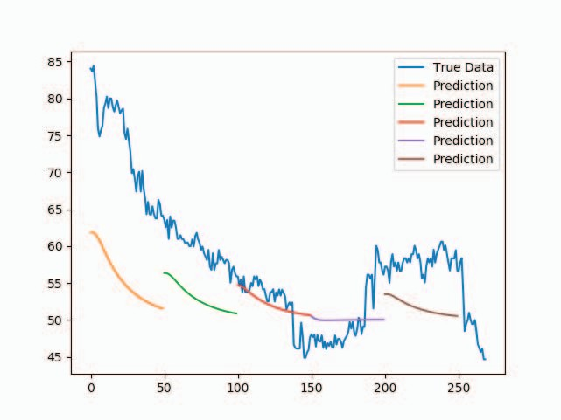
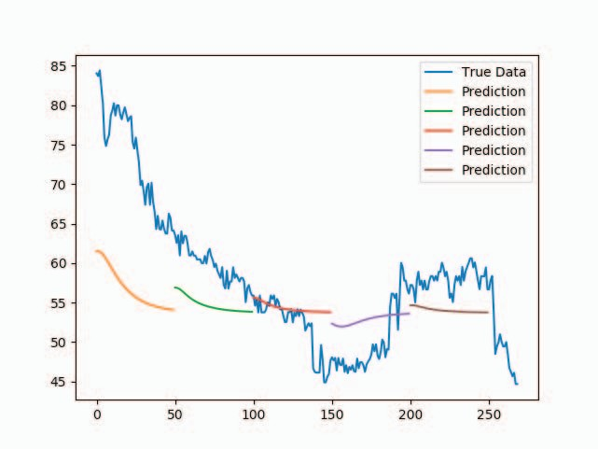
Prediction of Energy consumption with different attributes
Fig.1 Prediction of energy consumption with respect to temperature values
Fig.2 Prediction of energy consumption with respect to temperature and humidity values

Slide 8
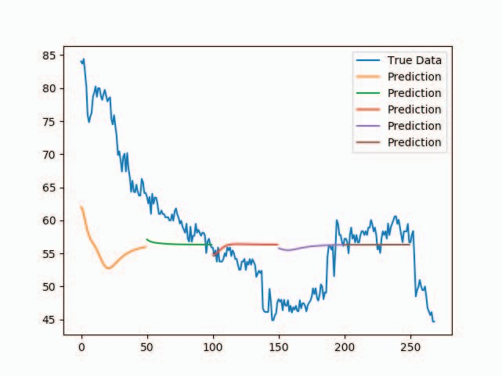
Fig.3 Prediction of energy consumption with respect to temperature, humidity values and occupancy values

Slide 9
References
[1] E. D. M. A. G. Dogan, T. Brown and J. Manorge, “Data analytics of building automation systems: A case study,” International Journal of Intelligent Systems and Applications in Engineering, vol. 2, pp. 123– 137, 06 2018.
[2] C. W. Potter, A. Archambault, and K. Westrick, “Building a smarter smart grid through better renewable energy information,” in 2009 IEEE/PES Power Systems Conference and Exposition, March 2009, pp. 1–5
[3] R. Bonetto and M. Rossi, “Machine learning approaches to energy consumption forecasting in households,” CoRR, vol. abs/1706.09648, 2017. [Online]. Available: http://arxiv.org/abs/1706.09648
[4] S. A. Kalogirou and M. Bojic, “Artificial neural networks for the prediction of the energy consumption of a passive solar building,” Energy, vol. 25, no. 5, pp. 479 – 491, 2000. [Online]. Available: http://www.sciencedirect.com/science/article/pii/S0360544299000869
[5] H. Shi, M. Xu, and R. Li, “Deep learning for household load forecasting—a novel pooling deep rnn,” IEEE Transactions on Smart Grid, vol. 9, no. 5, pp. 5271–5280, Sep. 2018.

